Slide 1
Unmanaged Query

Slide 2
Use Cases
Use cases for unmanaged queries are
the data source for an OData request is not a database table, but, for example another OData service, which is reached by an OData client proxy,
performance optimization with application specific handling,
using AMDPs with some query push-down parameters in the SQL script implementation,
forwarding the call to the analytical engines, or
enrichment of query result data on property or row level, for example when splitting rows for intermediate sums or condensing the filter result.

Slide 3
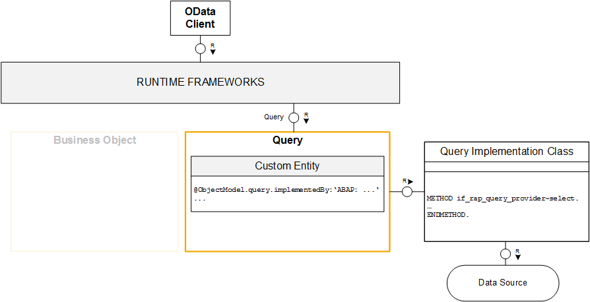
Runtime of an unmanaged Query

Slide 4
Consume ODATA Service

Slide 5
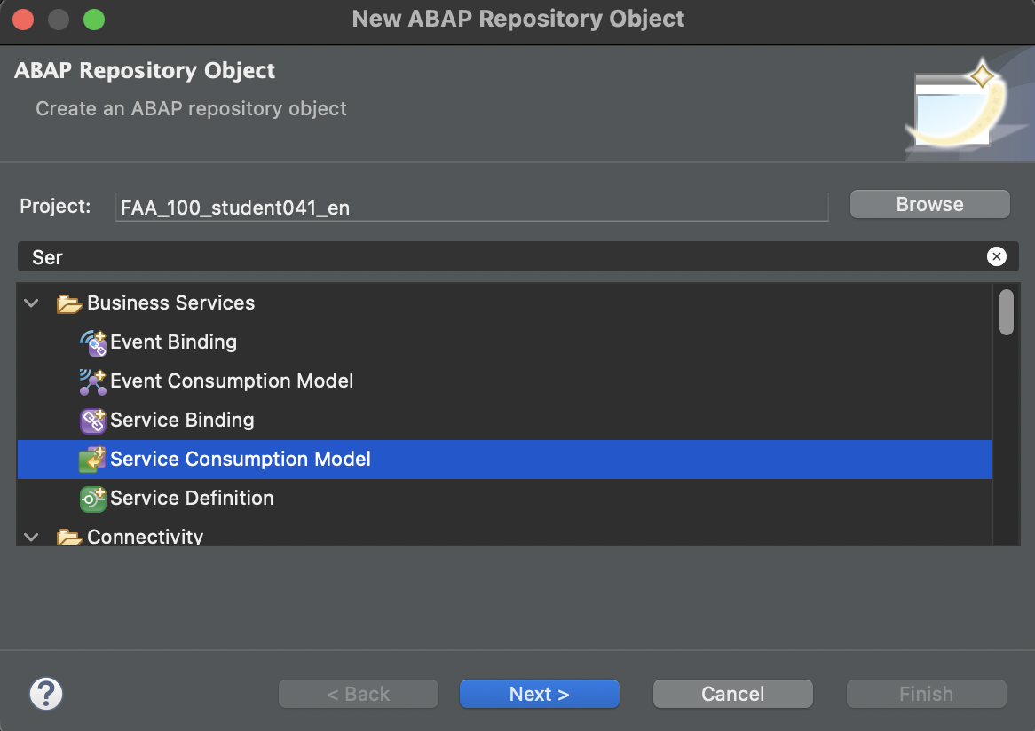
Create Consumption Model

Slide 6
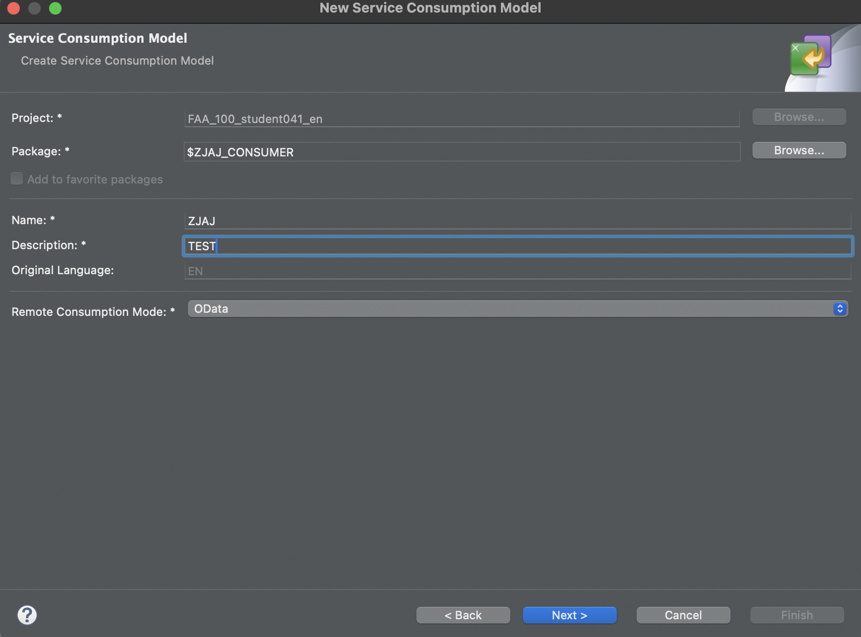
Create Consumption Model
Consumption models are possible for
Odata
Web Services (SOAP)
RFC.

Slide 7
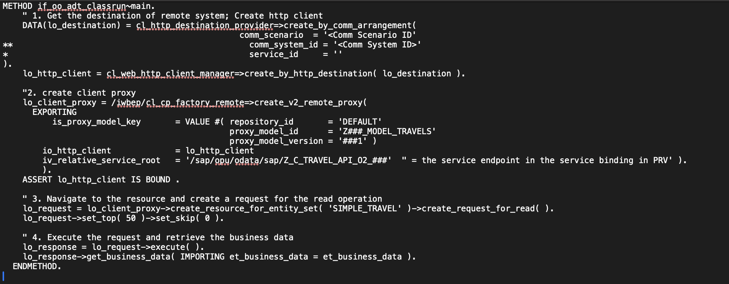
Example of consuming an ODATA
Interface: if_oo_adt_classrun
The type of ODATA structure is provided by the Consumption Model.

Slide 8
Excercise

Slide 9
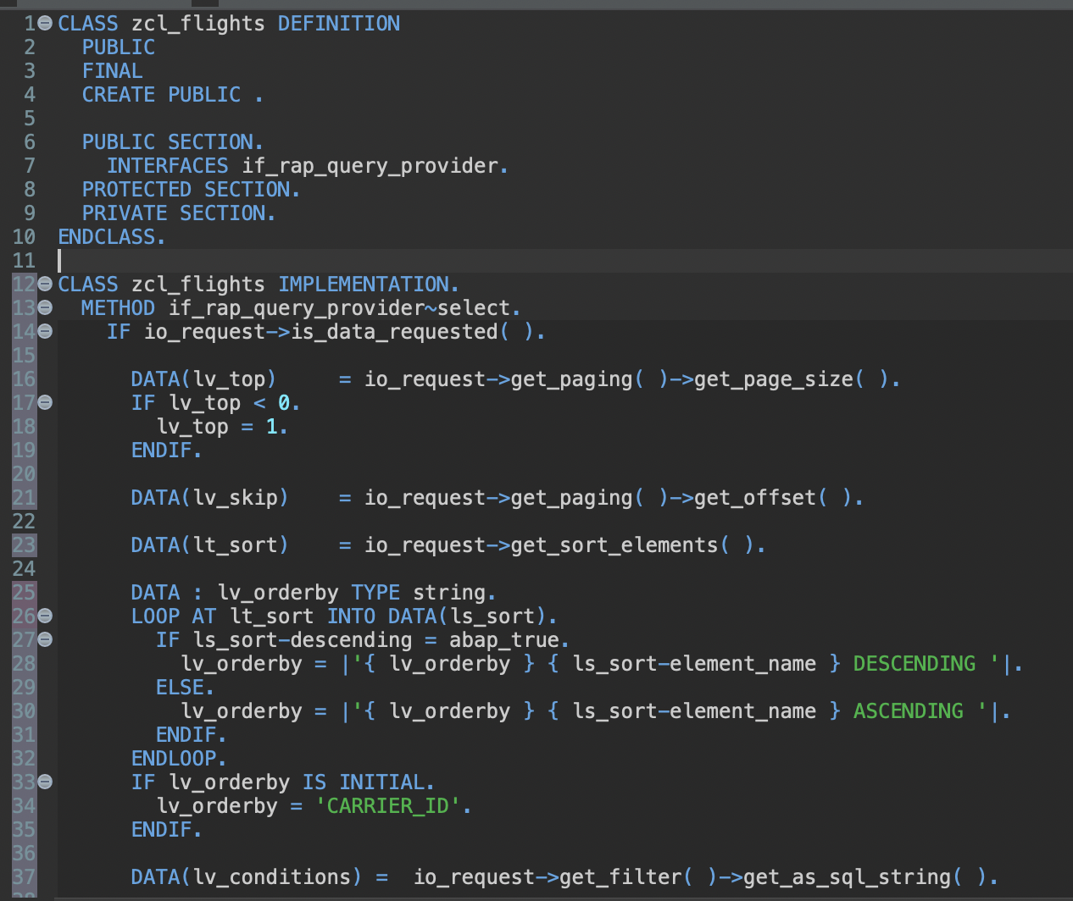
Create Query Provider Class
interface if_rap_query_provider

Slide 10
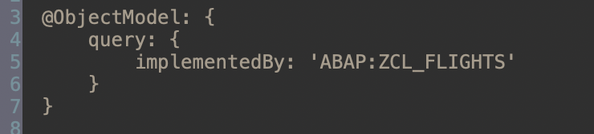
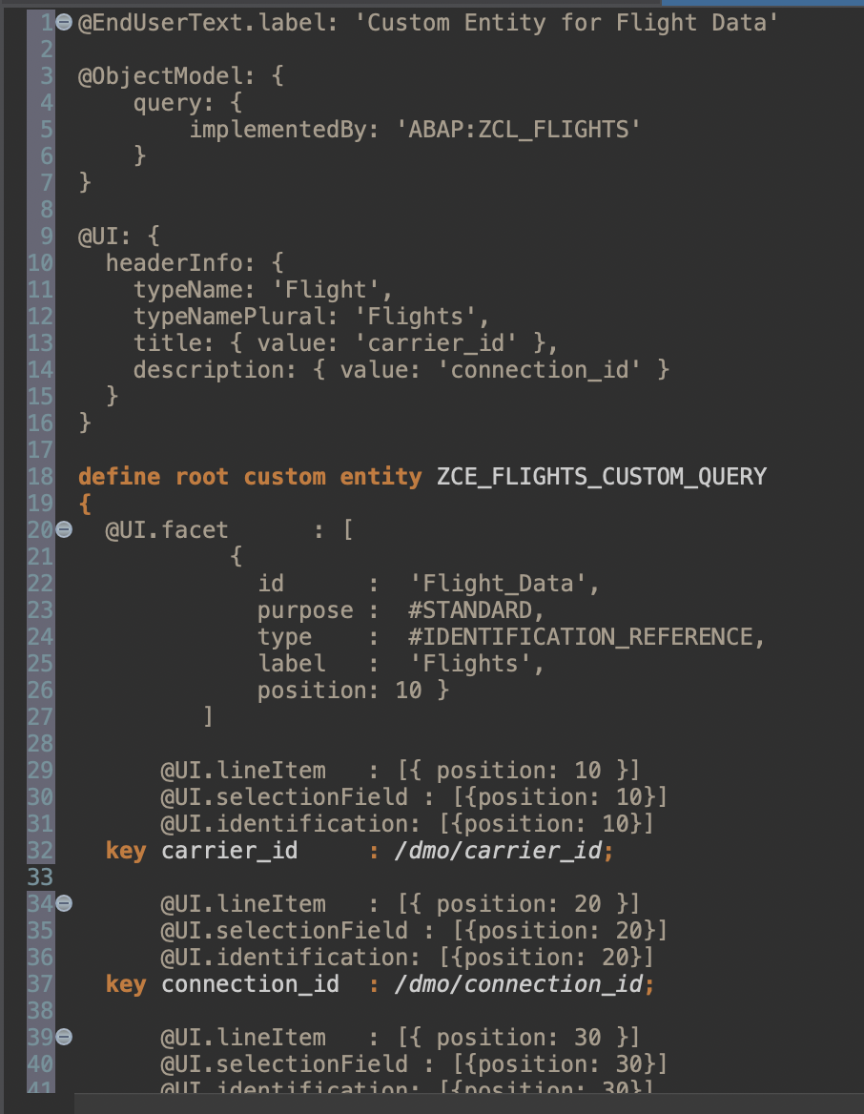
Create a custom entity
New annotation: implemented by ABAP class
Excercise: create a metadata extension and outsource metadata.

Slide 11
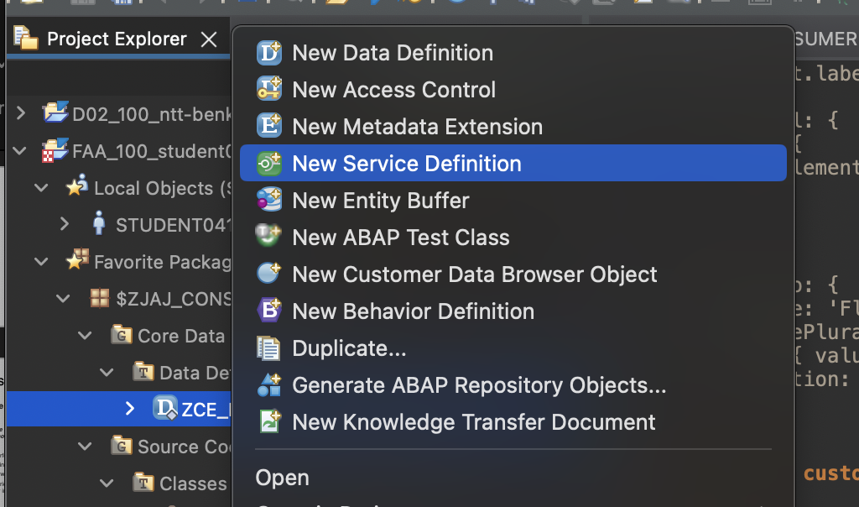
Create Service Definition

Slide 12
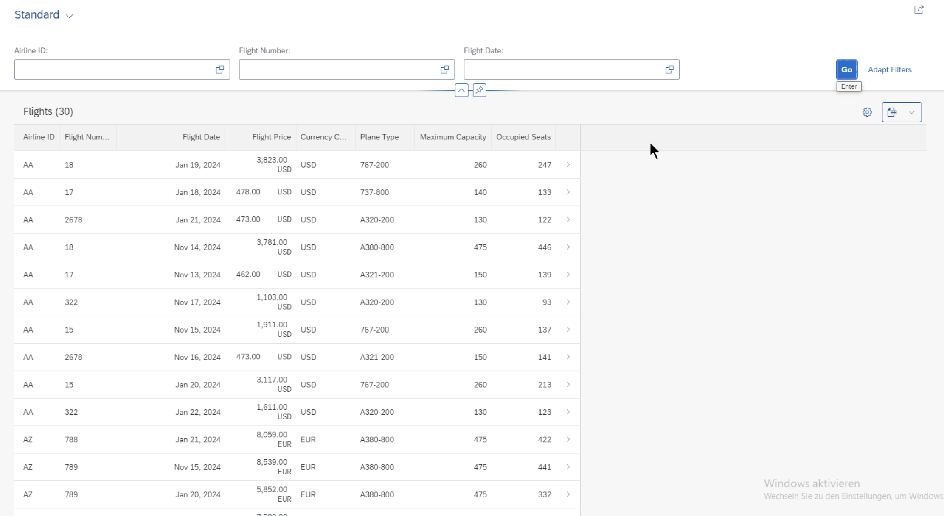
Create, activate and publish service binding

